Slide 1
Naïve Bayes classifier

Slide 2


Slide 3
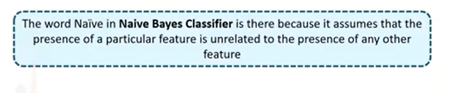

Slide 4

Naïve: It is called Naïve because it assumes that the occurrence of a certain
feature is independent of the occurrence of other features.
Such as if the fruit is identified on the bases of color, shape, and taste, then red, spherical, and
sweet fruit is recognized as an apple.
Hence each feature individually contributes to identify that it is an apple without depending on each other.
Bayes: It is called Bayes because it depends on the principle of Bayes' Theorem.

Slide 5
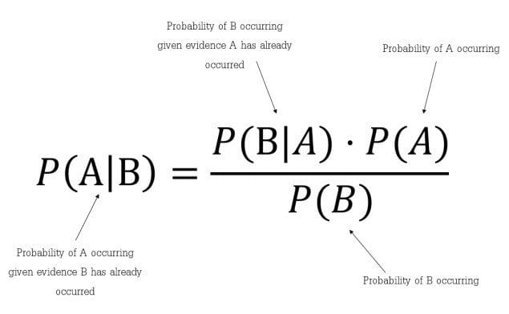
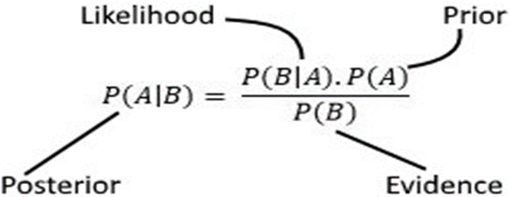

Slide 6
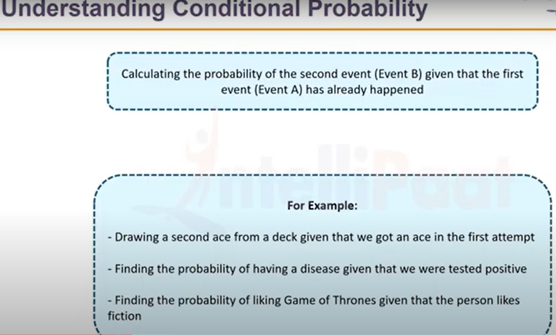

Slide 7
Naïve Bayes classifier
Naive Bayes classifiers are a collection of classification algorithms based on Bayes' Theorem.
supervised learning algorithm
it is a probabilistic classifier, which means it predicts on the basis of
the probability of an object.

Slide 8
Steps of Naïve Bayes:-
Convert the given dataset into frequency tables.
Generate Likelihood table by finding the probabilities of given features.
Now, use Bayes theorem to calculate the posterior probability.

Slide 9
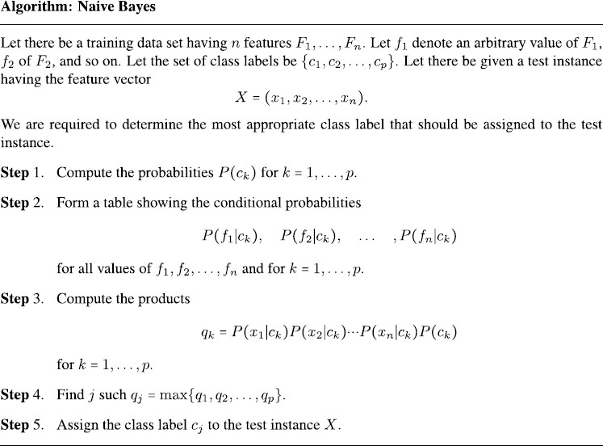

Slide 10
Advantages of Naive Bayes Classifier
It is simple and easy to implement.
It doesn't require as much training data.
It handles both continuous and discrete data.
It is highly scalable with the number of predictors and data points.
It is fast and can be used to make real-time predictions.

Slide 11
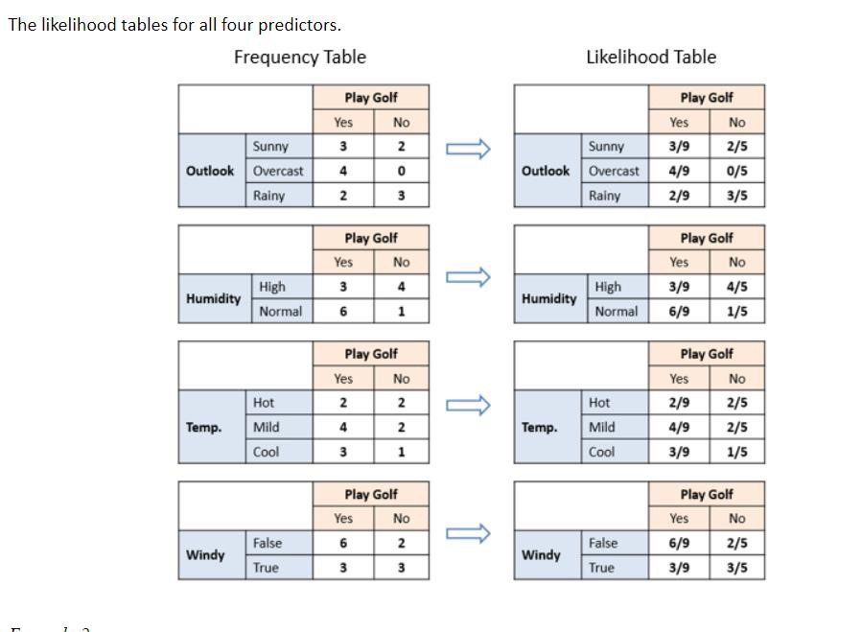
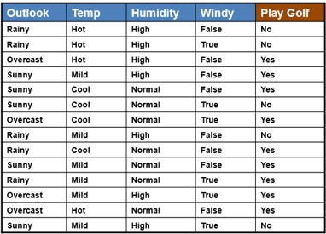
Naïve bayes problem 1:-
P(Yes)= 9/14 and P(NO)=5/14

Slide 12
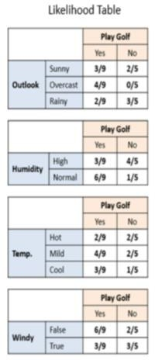
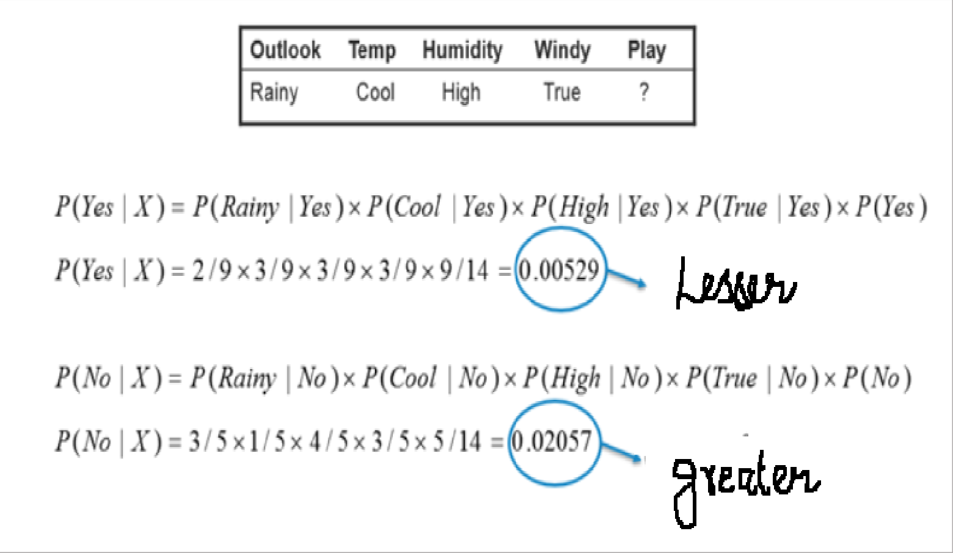
QUESTION
Answer: So, prediction that golf would be played is ‘NO ’.

Slide 13
Problem 2

Slide 14
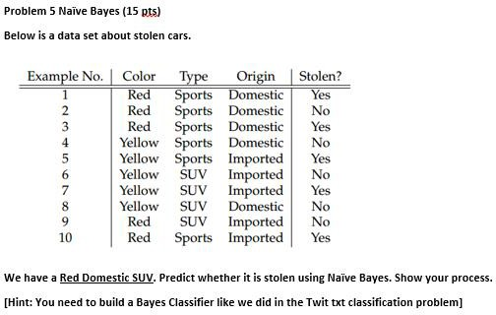

Slide 15
YouTube Videos
https://www.youtube.com/watch?v=XzSlEA4ck2I
https://www.youtube.com/watch?v=fOK9DiKUGYs

